Slide 1
Interview _ mini project
Amity Lu
Dec, 2023

Slide 2
The training variables:
- log_comments
- follower_count_at_t
- no_of_comments
- log_followers
After conducting a correlation analysis, it has been found that there is no significant relationship between these variables.
Best finding

Slide 3
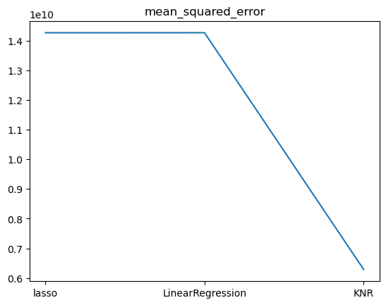
Best finding
The K-Nearest Neighbors Regressor, especially when k is small, outperformed Lasso and Linear Regression models in terms of MSE.

Slide 4
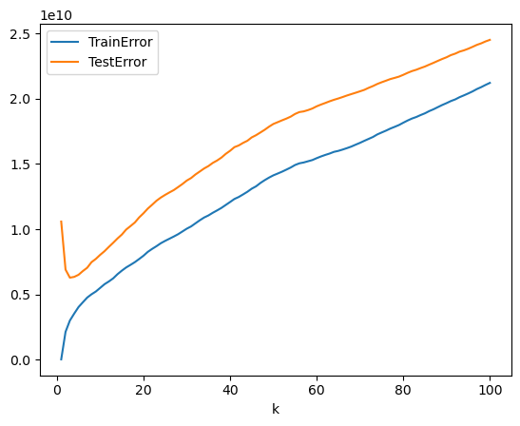
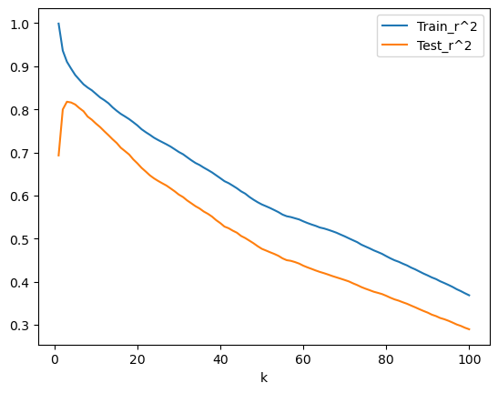
The KNR model was tested with various values of 'k'.
Best finding

Slide 5
The KNR model was tested with various values of 'k'.
Best finding
k = 3 has the lowest test error.
k | 3
MSE | 6289247605.729317
Train Error | 3.003110e+09
Test Error | 6.289248e+09
Train_R² | 9.105892e-01
Test_R² | 8.177050e-01

